Slide 1
Meeting Week 2
Last week overview
  Readings papers for model augmentation
    Mainly about orthonormality
This meeting:
  Are there any concepts from Kessels that are useful for dual-gantry?
  How can the orthogonality methods be used to overcome mentioned limitations in Kessels?
  (Additional paper dual-gantry methods)
Notes:
I scanned over Kessels for some potential useful concepts

Slide 2
Kessels
Inverse Mapping Parameter Updating (IMPU)
  Online phase keeps updating in real time → might cause an issue / conflicting with augmented approach.
    Calculating the subspace to avoid is expensive (uses SVD)
  Offline training – simulation environment
    Generate training dataset by randomizing Telica datasheet parameter ranges? Instead of collecting data first?
The Inverse Mapping Parameter Updating (IMPU) method (Thesis Part II) is designed to update physically interpretable parameters in real-time.
  Offline Training: Create a simulation environment using the lumped parameter model (Eq. 11 in the gantry paper). Generate a training dataset by randomizing these 14 parameters within the tolerance ranges specified in the Telica datasheet (e.g., mass variations due to cabling or payload).
  Excitation: Use the standard "pick and place" cycle defined in the Telica datasheet (acceleration 30-75 m/s², wait times 50-100ms) as the standardized experiment.
  Online Inference: Train the Artificial Neural Network (ANN) to map features extracted from the gantry’s tracking error
  Benefit: This allows the system to detect unbalanced friction
Feature Selection for Synchronization
  The gantry system has a unique performance metric: synchronization error; Kessels' Feature Selection (FS) strategies (Chapter 3), specifically Joint Mutual Information (JMI), can be used to identify which specific transient signal characteristics best predict this error.
    Implementation: instead of using raw time data, extract Time Extremum (TE) features (peaks in the error signal during acceleration phases) and Frequency (RI/MP) features from the error signals.
    Insight: The gantry paper notes that synchronization error is driven by the payload (Y-axis) acceleration torque. JMI would likely select features correlated with the Y-axis motion profile to accurately update the cross-arm parameters
Extension and Augmentation (EA) for Unmodeled Dynamics

Slide 3
Augmentation - Kessels
Augmentation (Correcting Force Equations):
  Problem: The gantry paper ignores "detent forces" (cogging forces from the linear motors) and assumes simple Coulomb/Viscous friction
  Solution: Use Kessels' augmentation strategy to add a Recurrent Neural Network (RNN) term to the force equations (fS​ in Eq. 15 of the gantry paper). This RNN would learn the nonlinear, position-dependent detent forces and cable drag that the analytical model misses.
  (Link to Orthonormality paper Maarten and Roland)
Extension (Adding Missing States):
  Dual-gantry 37.7 Hz: jerk rate → Instead use Kessels’ Subspace Encoder to introduce new states (x_excitation) to the state-space model → allows feedforward to compensate fr base vibrations
    Also allows to capture flexible modes
  (Papers Jan also have a solution for this)
Uncertainty Quantification (UQ) for High-Reliability Control:
  Telica system operates at 7,500 UPH (Units Per Hour)
    Kessels' Probabilistic Bayesian Neural Networks (PBNN) (Chapter 4) can be applied to the parameter updating process.
    Insteadof a single value for the payload mass, the system outpus a probability distribution.
      Benefit: If the gantry performs a move that doesn't excite the system enough to identify friction (high uncertainty), the PBNN will report a wide confidence interval. The control system can then decide not to update the feedforward gains based on this uncertain data, preventing instability

Slide 4
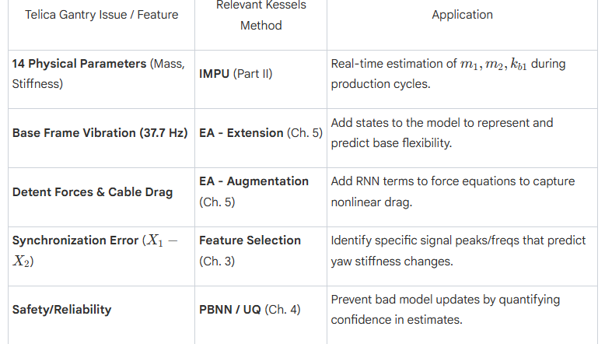

Slide 5
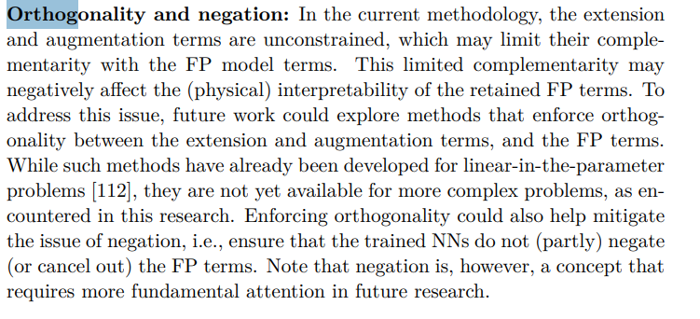
Augmentation - Orthonormality
Kessels mention limitation
How to combine physics based model → model augmentation
Data experiments

Slide 6
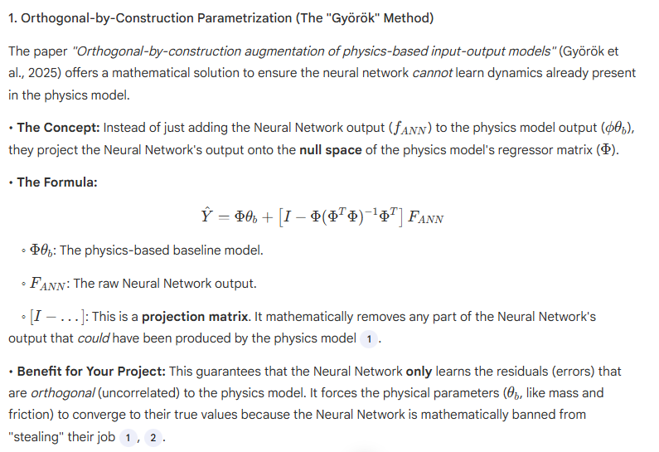

Slide 7
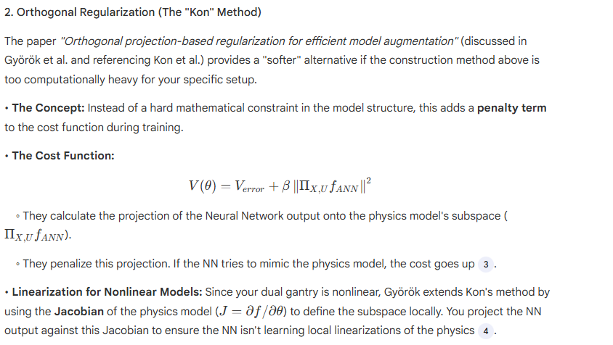

Slide 8
Action point 1
You should have a Gantt-chart or some other planning with what should be the next steps in the research.
Questions can also be put here
Some figure showing the result achieved like a plot or some theory.
When applicable, the same as will go in final report. Otherwise just take screenshots from relevant papers.

Slide 9
Question 1
If a question needs to be answered. Make clear here what the problem/question is that needs to be answered. Questions can always be asked outside the meeting, but we may say prepare to explain what you really mean.
Some figure explaining the concept
When applicable, the same as will go in final report. Otherwise just take screenshots from relevant papers.

Slide 10
Advanced Synchronization Control of a Dual-Linear-Motor-Driven Gantry With Rotational Dynamics
Detailed Modeling of Bearing Stiffness
  While García-Herreros models the flexible joints simply as lumped springs (kb1​), Li et al. provide a more detailed physical derivation of where this stiffness comes from.
  The Insight: They model the linear guide rails as distributed horizontal springs. They derive an "equivalent rotational stiffness" (Kα​) by integrating the stiffness of the bearing balls over the length of the carriage block
Rotational Friction Modeling
  The García-Herreros paper explicitly ignored the torque associated with friction to simplify their decoupling control. Li et al., however, demonstrate that friction is critical in the rotational dynamics.
  The Insight: They include a term Fri​ (combined viscous and Coulomb friction) directly in the rotational dynamics equation: They show that differences in friction between rail 1 and rail 2 (B1​=B2​) contribute to the synchronization error.
    Relevance: If your "Physics-Informed" neural network is trying to learn missing dynamics, explicitly including this friction asymmetry in your baseline physics model (which García-Herreros omitted) will reduce the burden on the neural network, preventing it from having to "learn" basic friction physics that could have been modeled analytically.
Internal Force Regulation
introducing Adaptive Robust Control (ARC), which actively learns and compensates for the errors that the decoupling method neglects.

Slide 11
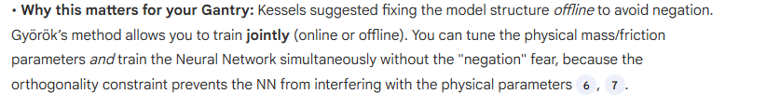
How can Adaptive Robust Control enhance gantry synchronization?
Online Parameter Adaptation (how useful is Online Parameter Adaptation, if we add an augmented model on top? wont this just interfere?)
Advice: Follow Kessels' recommendation to update the model structure offline first (fixing the missing physics), and then update the parameters online using that enhanced structure.
Does this fix the issue?:

Slide 12
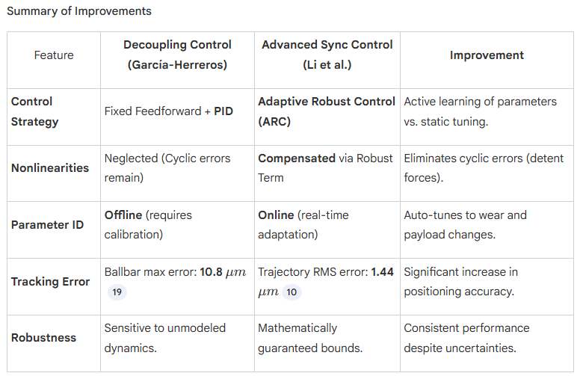
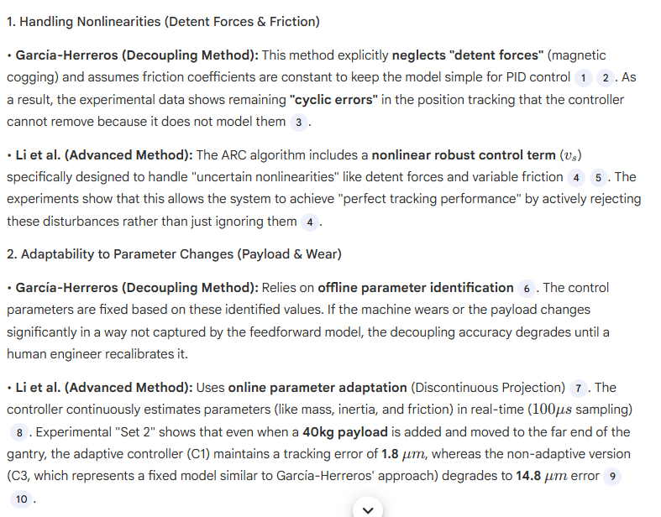

Slide 13
Outline next week
What is next on the planning and how is that going to be solved
This is also where new action points are formulated. What are you going to do next week.

Slide 14
Possible Gantt-chart or Planning
To keep an overview of what the progress overall is.

